Slide 1
Transformerless DC-DC Converters with High Step-Up Voltage Gain
Switched Mode Power Conversion
Yamini Kumari 20BEE1032
Sabareesh M 20BEE134
Udhaya Shankar P 20BEE1028

Slide 2
Abstract:
This paper introduces a novel transformerless DC-DC converter architecture to achieve high step-up voltage gain without the traditional dependence on duty ratio modulation. The proposed converter leverages a unique combination of circuit topology and control strategy, allowing for efficient voltage conversion without the need for complex duty ratio adjustments. The transformerless DC-DC converter with high step-up voltage gain, free from duty ratio modulation constraints, offers a promising solution for applications in renewable energy systems, electric vehicles, and other power-hungry devices. This research contributes to advancing the state-of-the-art in transformerless power conversion by introducing an innovative approach to achieve high voltage gain without the need for duty ratio modulation.

Slide 3
Objectives:
The primary objective of this research is to design, analyze, and implement a transformerless DC-DC converter
To achieve high step-up voltage gain without relying on duty ratio modulation.
To implement in MATLAB
To develop a hardware model.

Slide 4
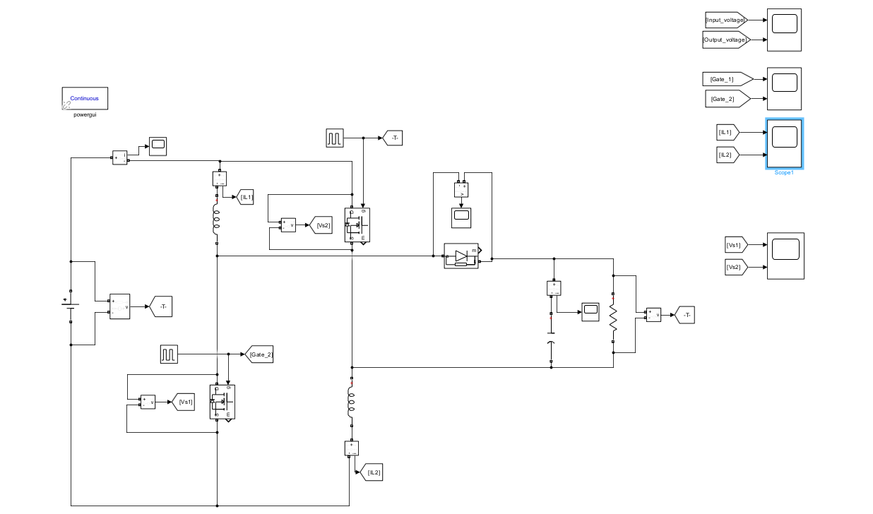
Matlab Simulation:

Slide 5
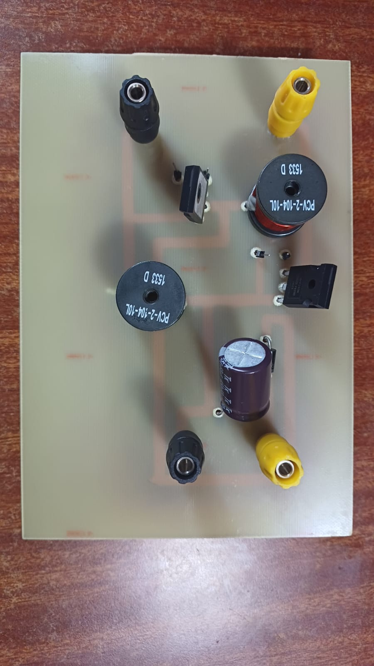
Hardware

Slide 6
Design Specification:
S.NO | COMPONENTS | RATING | COST
1 | Inductor (2) | 100µH, 10A | 400
2 | Capacitor (1) | 68µF, 450V | 350
3 | MOSFET (2) | IRF250N | 300
4 | DIODE (1) | MUR460 | 100

Slide 7
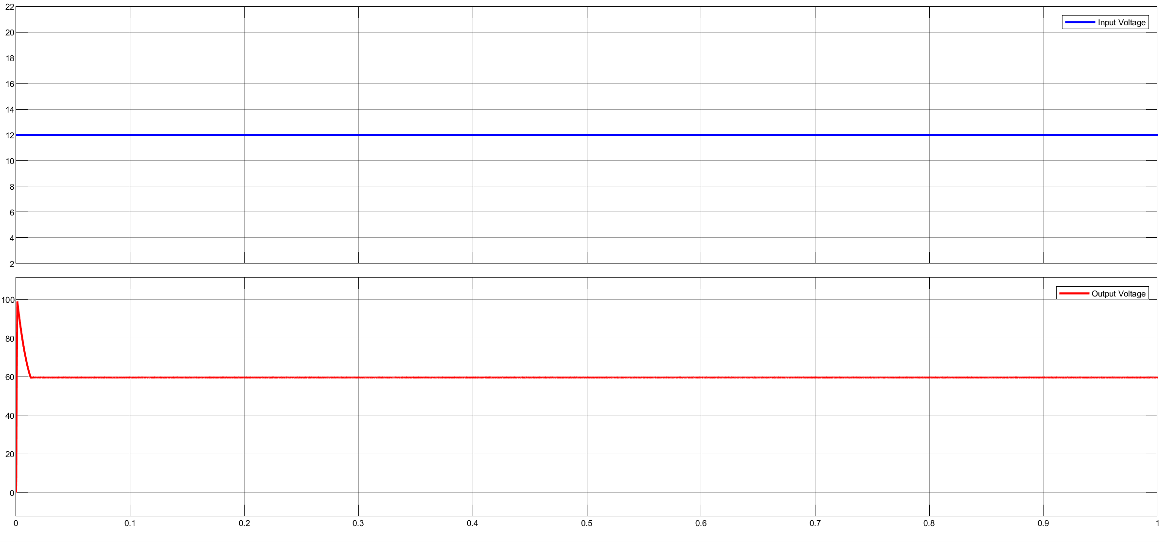
Input and output voltage graph:

Slide 8
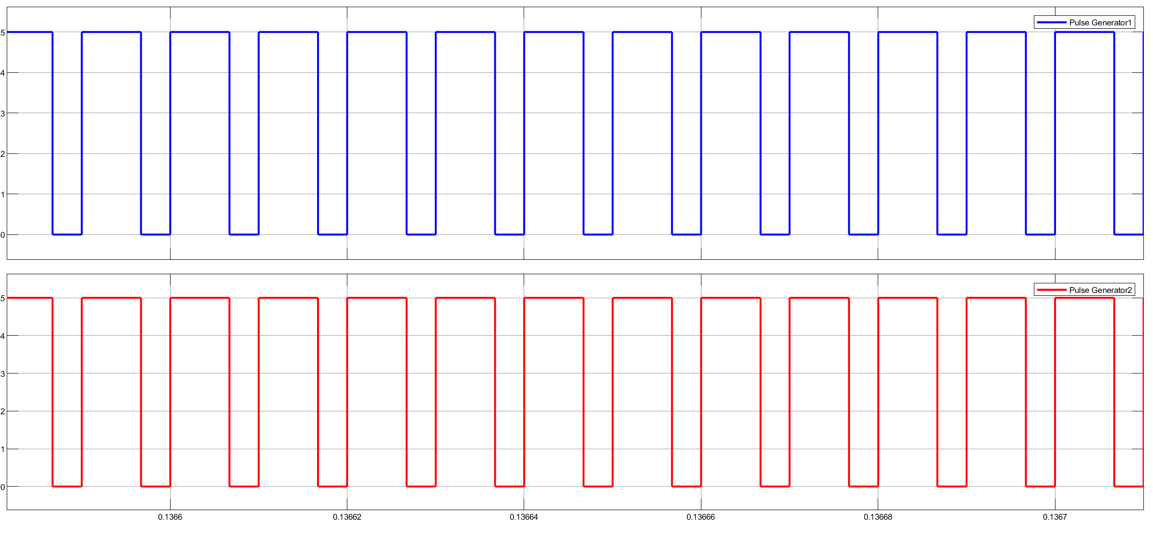
Pulse Generator:

Slide 9
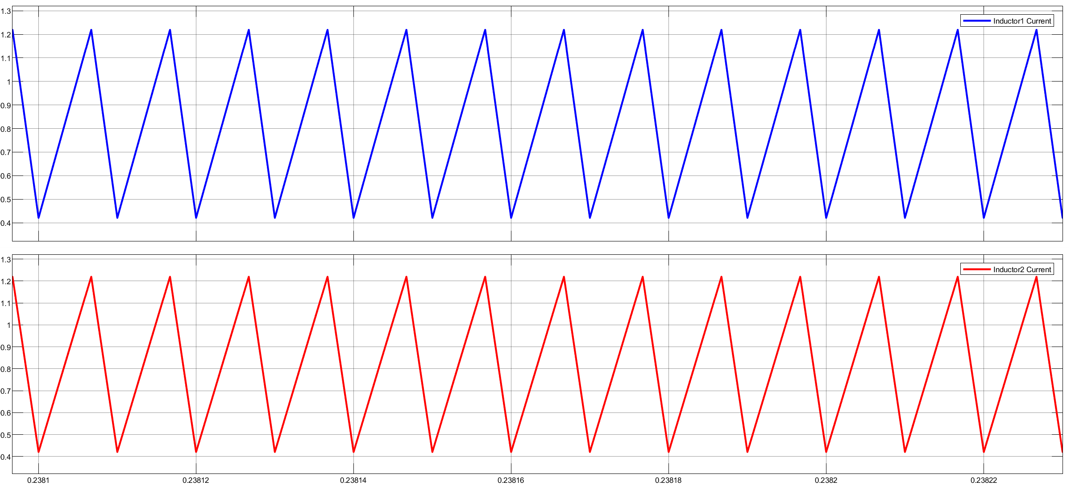
Inductor current:

Slide 10
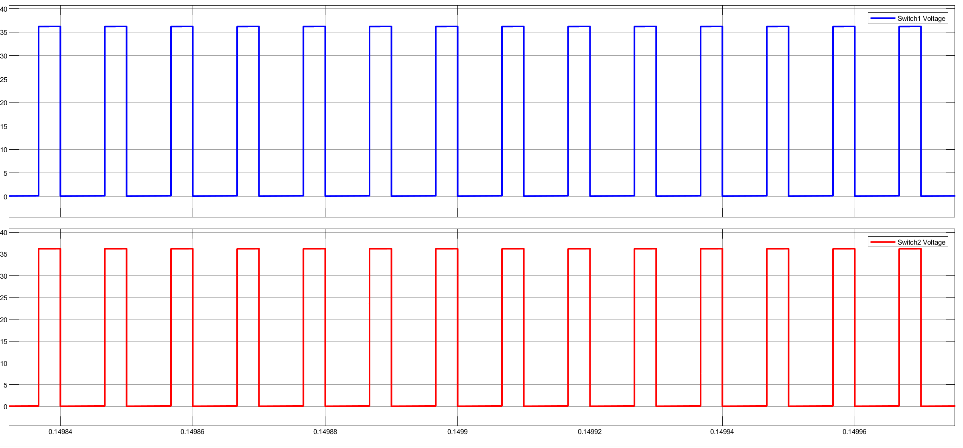
Switch voltage:

Slide 11
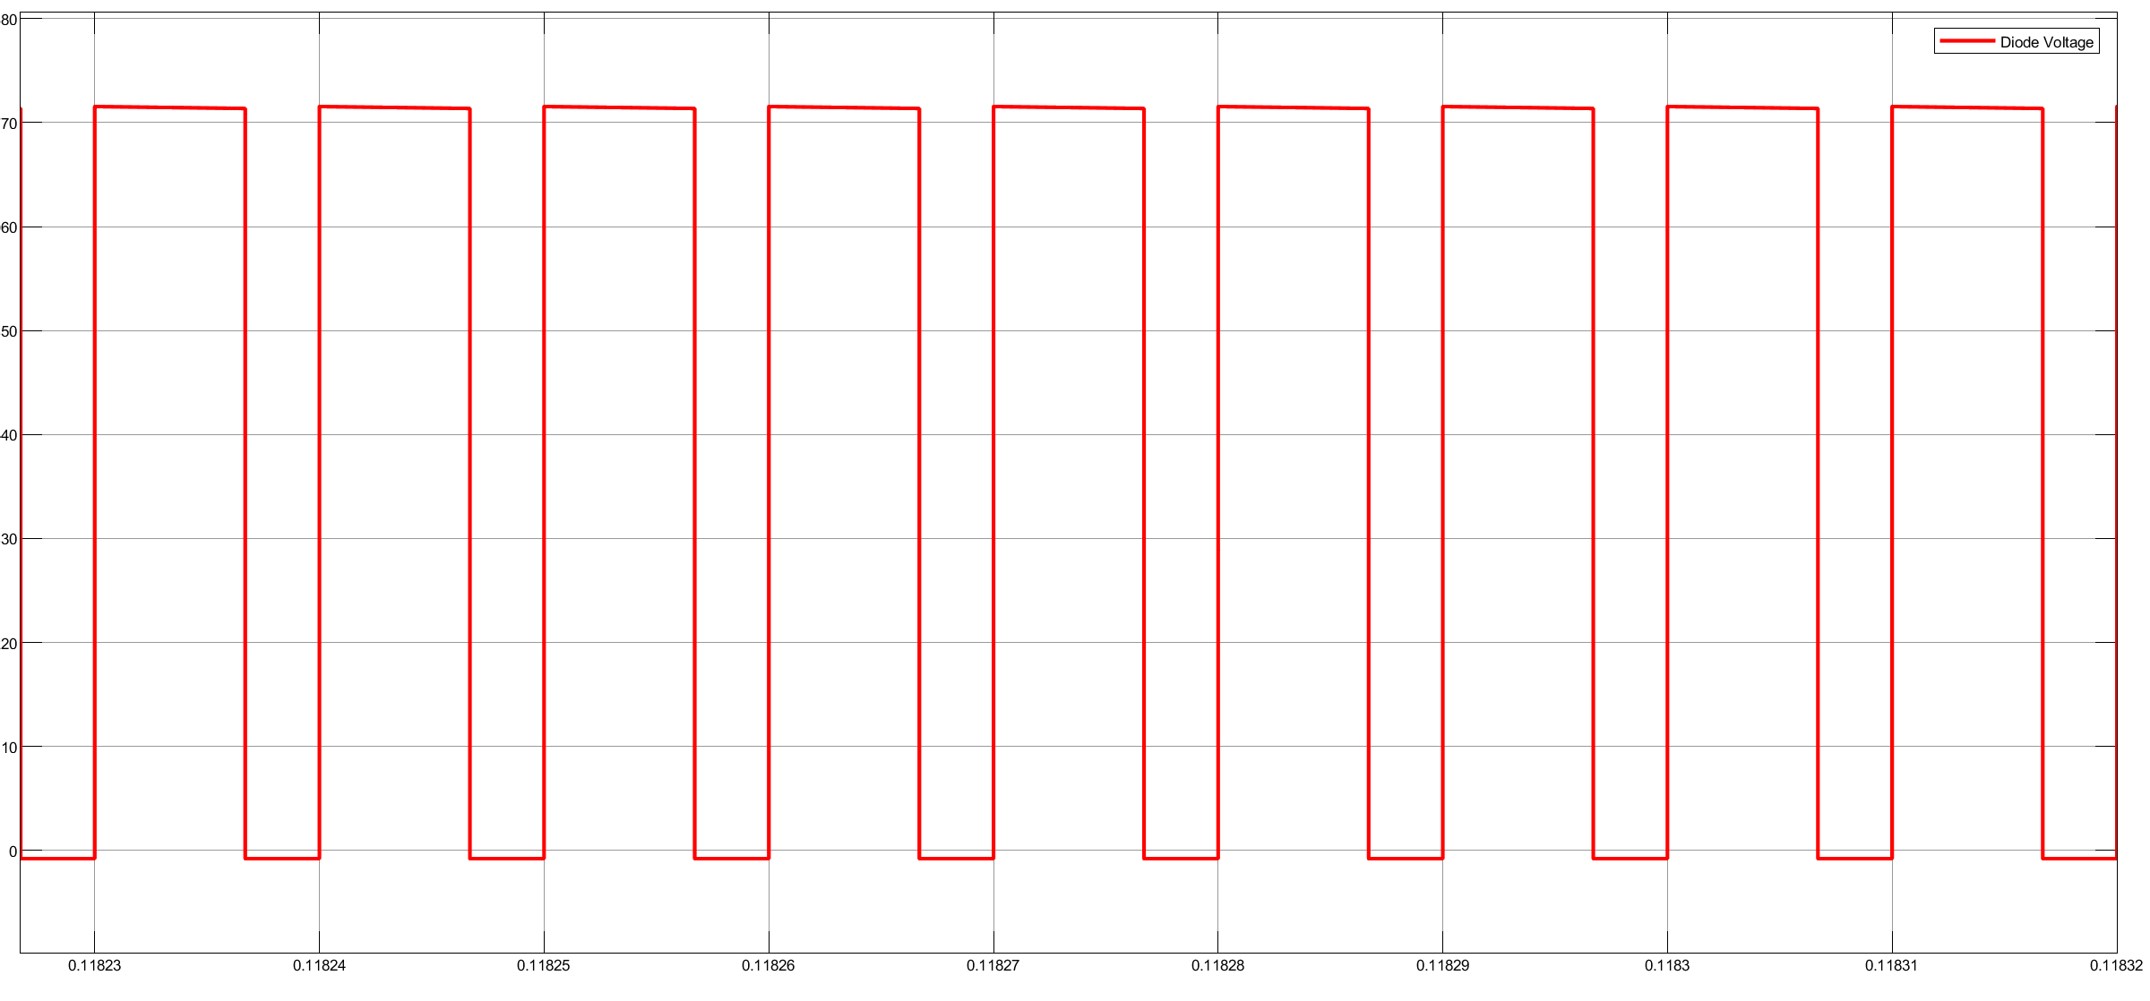
Diode voltage:

Slide 12
Conclusion:
In conclusion, the development of a transformerless DC-DC converter to achieve high step-up voltage gain without duty ratio modulation represents a significant stride toward enhancing the efficiency and simplicity of power conversion systems. Comparative studies showcased the advantages over conventional transformer-based converters and other transformerless designs, emphasizing the simplicity, reduced control complexity, and enhanced reliability of the proposed approach..

